Slide 1
INSTRUCTIONAL SYSTEMS DESIGN
Overview of Learning Theories
by Carrie Wright

Slide 2
Learning Theories
Behaviorism
Based on observable changes in behavior
1
Cognitivism
Based on the thought process behind the behavior
2
Constructivism
Based on the premise that we all construct our own perspective of the world through individual experiences and schema
3

Slide 3
Behaviorism
Based on observable changes in behavior
Focuses on a new behavioral pattern being repeated until it becomes automatic
Overt behaviors that can be observed and measured quantitatively
Learning that occurs through the behavioral response to stimuli

Slide 4
Criteria of Behaviorism
The instructional task is the focus of a behavior response
Learning occurs through the influence of environmental stimuli
Learning occurs through the process of repetition or rehearsal

Slide 5
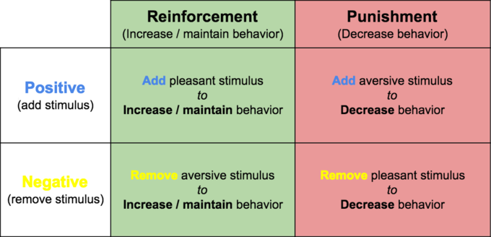

Applications of Behaviorism
Behavior response & Environmental stimuli
A+
C-
This Photo by Unknown Author is licensed under CC BY-SA-NC
Great Job!
Prizes!
This Photo by Unknown Author is licensed under CC BY-SA

Slide 6

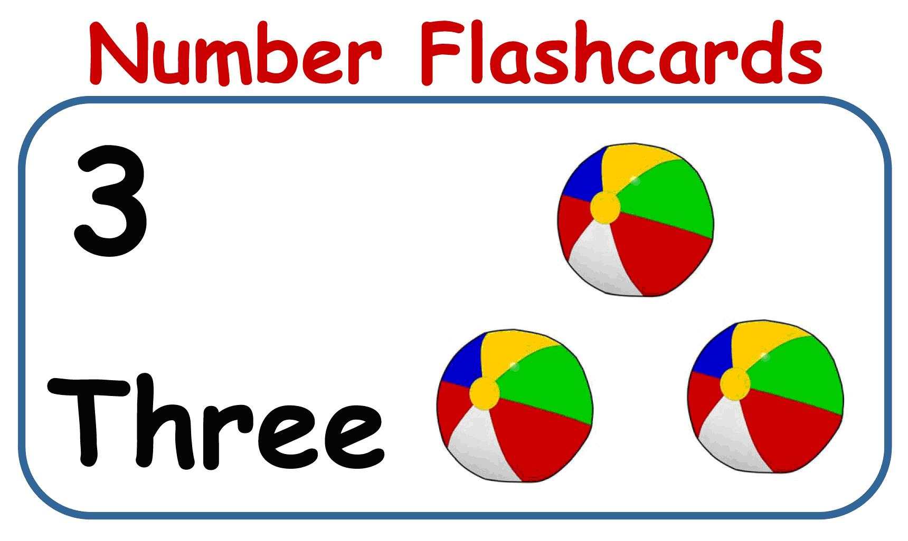
Applications of Behaviorism
Rehearsal & Repetition
This Photo by Unknown Author is licensed under CC BY-SA
This Photo by Unknown Author is licensed under CC BY-NC-ND

Slide 7
Cognitivism
Puts the learning focus on the individual (reorganization of experiences to make sense of the stimuli)
Development of knowledge by the creation of schemas (mental database)
Gestalt theory – organization of visual elements into groups or unified wholes when certain principles are applied
Information Processing Theory - based on the idea that humans process the information they receive, rather than merely responding to stimuli.
Notes:
Gestalt is a psychology term which means "unified whole". It refers to theories of visual perception developed by German psychologists in the 1920s. These theoriesattempt to describe how people tend to organize visual elements into groups or unified wholes when certain principles are applied.
Developmental psychologists who adopt the information-processing perspective account for mental development in terms of maturational changes in basic components of a child's mind. The theory is based on the idea that humans processthe information they receive, rather than merely responding to stimuli.

Slide 8
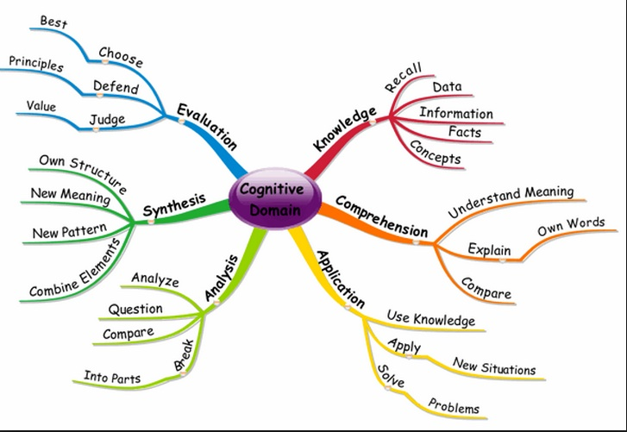
Cognitivism Key Concepts
Schema
Three-stage information processing model
Short-term memory
Long-term memory
Transfer Effects
Interference Effects
Organization Effects
This Photo by Unknown Author is licensed under CC BY-NC

Slide 9


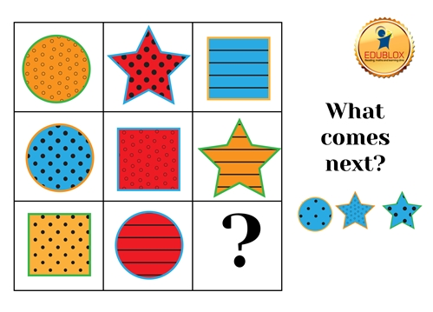
Applications of Cognitivism
Making a judgment about something
based on information you received
Making connections to prior knowledge
Ability to reason through logic
=
If 1 + 1 = 2 then 2 + 2 = 4
This Photo by Unknown Author is licensed under CC BY-SA

Slide 10
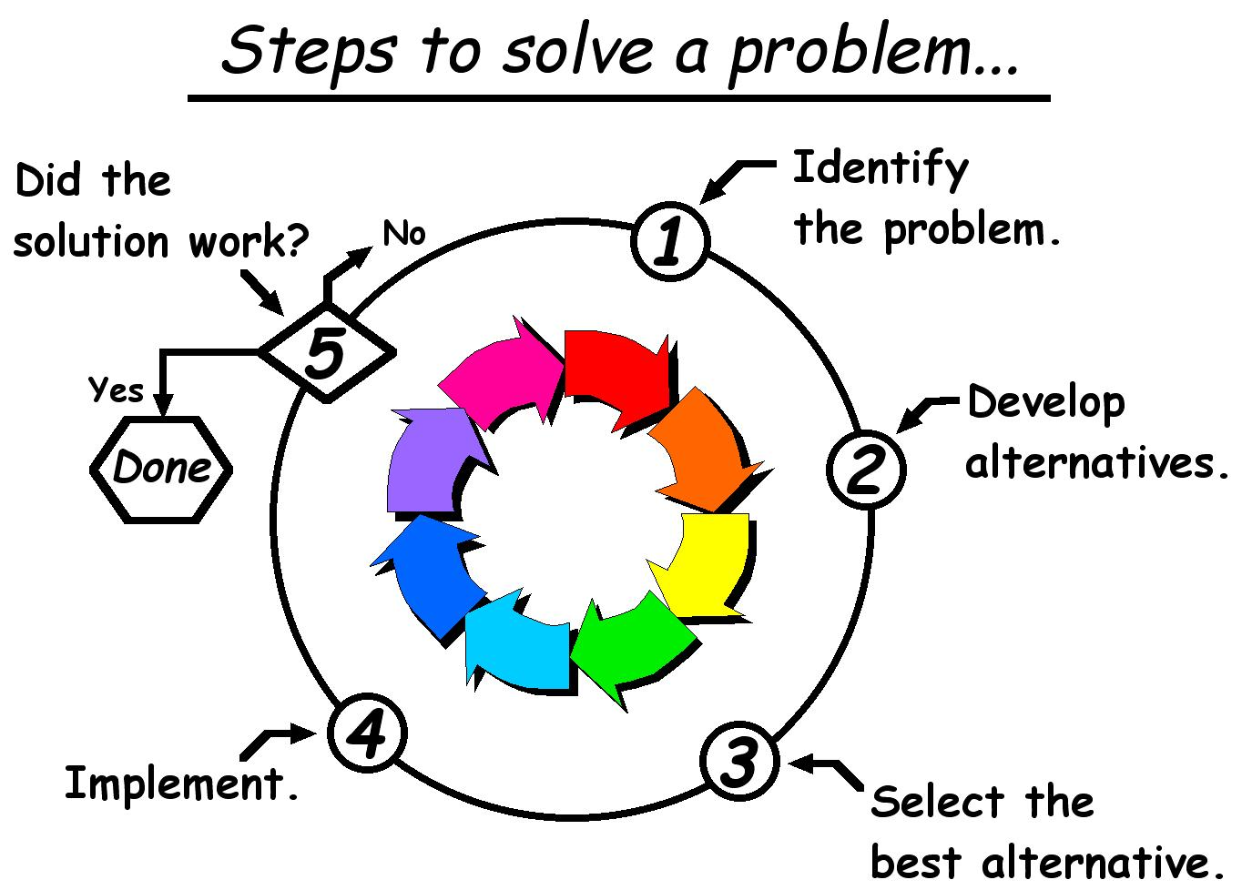
Applications of Cognitivism
Ability to solve problems
Cognitive abilities are
different depending on
the person’s age
This Photo by Unknown Author is licensed under CC BY-SA
This Photo by Unknown Author is licensed under CC BY-SA

Slide 11
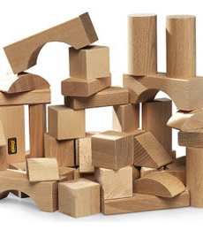
Constructivism
Learners construct their own reality
One’s own prior experiences, mental structures, & beliefs are used to interpret objects & events
Learner constructs knowledge

Slide 12
Constructivism Assumptions
Knowledge & meaning are constructed on basis of experience
Personal interpretation of the world
Conceptual growth accomplished through
– sharing of multiple perspectives
-- negotiation of meaning
-- change through collaboration
Testing should be integrated with the task

Slide 13
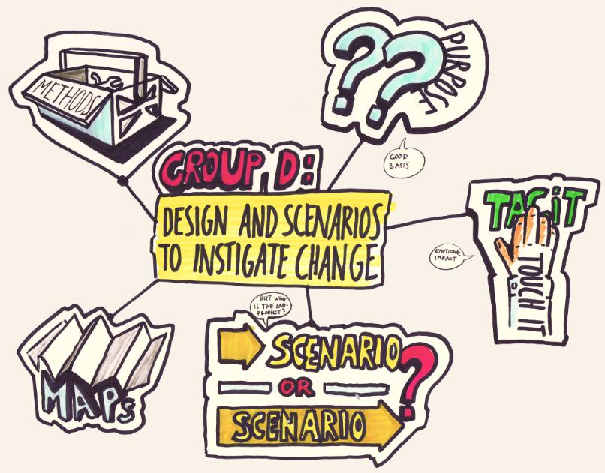
Applying Constructivism
Use real-world scenarios
Enable dialogue
Provide questions instead of answers
Socratic questioning
Consider time limit for activities
This Photo by Unknown Author is licensed under CC BY-SA-NC

Slide 14
Compare/Contrast Learning Theories
Behaviorism | Based on the thought process behind behavior What the learner does Response to stimuli
Cognitivism | Behavior changes observed & used as indicators as to what is happening in the learner’s mind Processes information Organizes information from prior schema (database)
Constructivism | Learners construct mental models Interprets information and applies to their own reality
My observation: The above theories build upon one another while person is experiencing learning

Slide 15
References
https://gsi.berkeley.edu/gsi-guide-contents/learning-theory-research/behaviorism/
Wikipedia
http://www.softschools.com/examples/science/cognitive_psychology_examples/36/
http://blog.neolms.com/practical-applications-constructivism-online-classroom/
https://prezi.com/plocwqe2utf7/similarities-differences-of-behaviorism-cognitive-theories-constructivism/
https://ripslawlibrarian.files.wordpress.com/2017/03/bcc-chart.jpg

